Slide 1
Boston College?
Norwood High School
EARLY COLLEGE
READINESS NIGHT
UMass Dartmouth?
Mass Bay?
Providence College?
Middlebury?
Anna Maria?
Harvard?
Stonehill?

Slide 2
Tonight’s Agenda
Overview of College Exploration & Admission Process – NHS Guidance
Hear from the Experts:
Evan Grenier, Associate Dean of Admission @ Stonehill College
Michael Lynch, Director of Admission @ Umass Dartmouth
Question & Answer

Slide 3
COLLEGE PLANNING TIMELINE
HIGH SCHOOL CAREER | FRESHMAN & SOPHOMORE YEAR | JUNIOR YEAR | SENIOR YEAR
Visit & research colleges Maintain academic progress in college prep classes Become involved in extra-curricular activities Save for college expenses | Make an academic plan by identifying courses to take during high school Take the PSAT (fall of sophomore year) Complete the FAFSA4caster - estimates your eligibility for federal student aid Gain access to Naviance, NHS’s college & career planning tool Naviance – update resume, take Career Interest Profiler, & generate a list of prospective colleges | Take the PSAT again (fall of junior year) Pursue roles in extra-curricular activities that suit your strengths & interests Attend the NHS Career Fair Sign up to tour college campuses Take the SAT and/or ACT in the spring (may also need to take SAT Subject Tests depending on college admission requirements) Start drafting your college essay Ask teacher(s) to write letter of recommendation | SEPT - DEC Register to take the SAT and/or ACT again in October or November Review requirements and deadlines of prospective colleges Manage admissions and financial aid application deadlines DEC - FEB Complete FAFSA Apply for private scholarships MARCH - MAY Receive admission decisions Financial aid letters are sent MAY 1st National Tution Deposit Deadline
Some information taken from www.MEFA.org

Slide 4
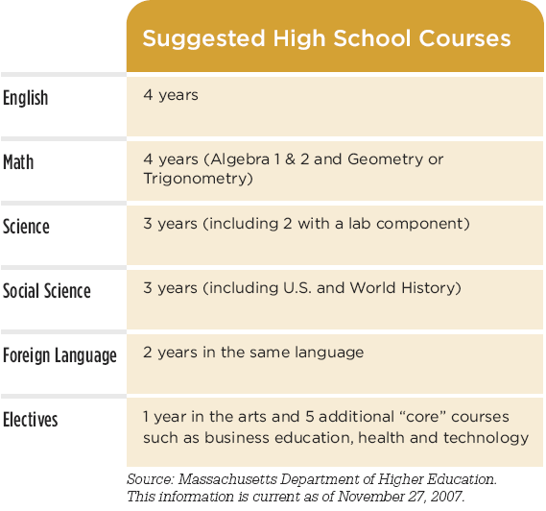
Make an Academic Plan
Course plan recommended by MA Department of Higher Education to prepare for college and career.
Source: www.MEFA.org
Notes:
This course plan may be the bare minimum; many competitive institutions will look for 4 years of study in each academic core (English, Math, Science, Social Science)
Introduce the graduation requirements at your High School, which may be different from the plan listed on the slide.
Familiarize yourself and your colleagues in guidance with the federal Academic Competitive Grants, which are awarded to Pell grant recipients who have taken a “rigorous high school program” as defined by the state.
The course plan (“Mass Core”) from the MA Board of Higher Ed meets the federal requirements for “rigorous high school program”
Among other qualifying programs, a student could take two AP or IB courses in high school and earn a passing grade (3 on AP or 4 on IB) in each.

Slide 5
Academic Preparation
Exceed minimum requirements
Take classes relevant to college plans
Good grades vs. challenging classes
Try to improve your grades over time
Explore your favorite subjects
Source: www.MEFA.org

Slide 6
College Entrance Exams
PSAT: Grade 10 and 11
SAT and ACT: Grade 11 and 12
SAT Subject Tests: Check college’s requirements
Advanced Placement Exams
Test Optional Schools (www.fairtest.org)
SAT Prep Course @ NHS
Source: www.MEFA.org

Slide 7
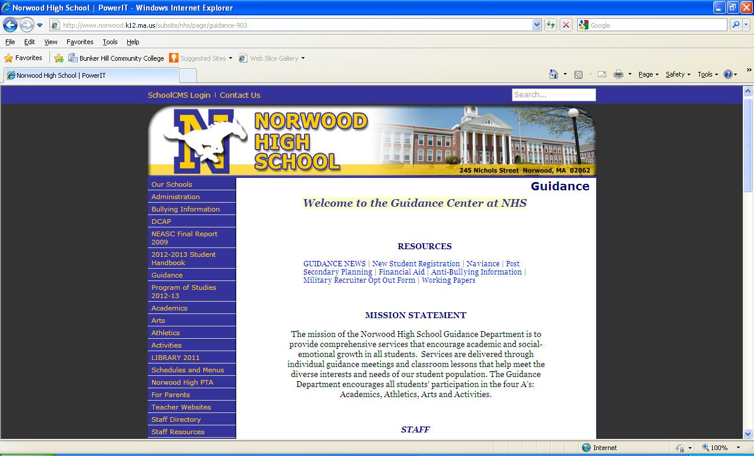
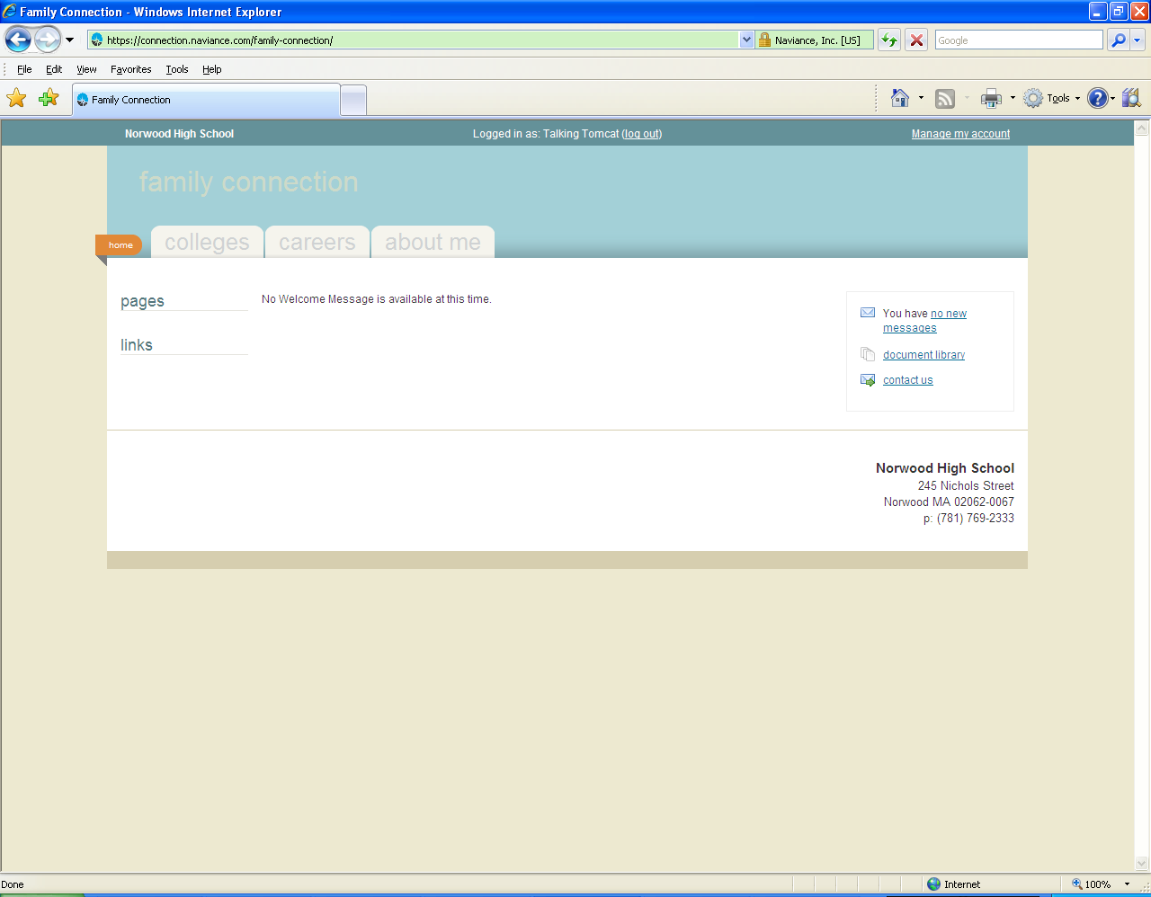
Online Resources
NHS Guidance Website
www.norwood.k12.ma.us/subsite/nhs
NAVIANCE
Web-based resource that supports college & career planning
Specific to Norwood High School
Student and Counselor Access
http://connection.naviance.com/norwood

Slide 8
College & Post-Secondary Fair @ NHS!
Wednesday, May 28th
2:30pm in the Dining Hall
All NHS students are invited to attend!
Over 60 local colleges/universities, vocational programs, and military branches will be in attendance.
Great opportunity to ask questions!

Slide 9
LET’S HEAR FROM THE EXPERTS!
Mr. Evan Grenier
Associate Dean of Admission @ Stonehill College
Mr. Michael Lynch
Director of Admission @ University of Massachusetts, Dartmouth

Slide 10
THANKS FOR COMING!

