Slide 1
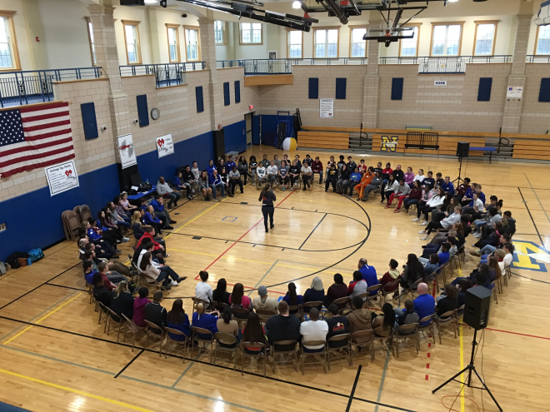
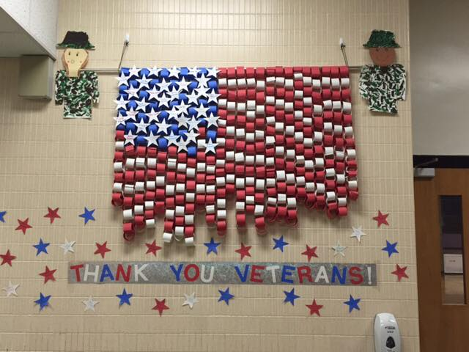

FY18 Preliminary Budget
December 14, 2016

Slide 2
STRATEGIC GOALS
  Prepare all students to be college or career ready
  Technology Integration
  Social Emotional Needs of Students
  Maximize parent & community relationships to support student learning
  Facility Improvements & Upgrades

Slide 3
Budget Team
James Hayden Ann Marie Ellis
Alec Wyeth Jean Selines
Bob Griffin Brianne Killion
Diane Ferreira Wesley Manaday
Paul Riccardi Paula Alexander
Carole Poirier Jackie Mann
Jonathan Longley Jonathan Bourn
Cathy Connor-Moen Nancy Coppola
Joe Kidd Department Heads
Jill Driscoll Teachers

Slide 4
1st Pass Budget
Class Size & Salary Adjustments
(See next page in green)
Level Services
Collective Bargaining
Reserves Added

Slide 5
←Future Needs→

Slide 6
What are our mandates?
Transportation over 2 miles Grades 1-6 - Local & Parochial schools
Out of District Placements - 62 students including full transportation
Special Education Services – Local & Parochial schools
504 Services
Bullying & Suicide Prevention Programs
Child Abuse Reporting by Counselors
School Lunch Program
Federal Title I services - Local & Parochial schools
Title II – Professional Development for all educators
Title III – Teaching time, testing, translation services
Title IX – equal programs for boys & girls
Computerized mandated MCAS & Access testing
Medical Screenings- eyes, ears, mental health
Mentor Training & New Teacher Induction Program
Hours spent compiling reports for Federal & State agencies
Computerized student information system requirements (SIS compatible)
Civil Rights Rules & Regulations

Slide 7
How do Grants help stretch our local budget?
27 FTE’s

Slide 8
What Fees & Revolving Funds were used
to Supplement the Budget?

Slide 9
 | FTE Changes from Town Meeting
11.6 | Paraprofessionals - Loss of K Grant & more one to one support
3.3 | Elementary Teachers for class size issues
0.2 | Speech Support
0.5 | Transportation for School Lunch, Fine Arts & Repairs
15.6 | Total

Slide 10
5 Year School Budget Comparison
1st Pass
Budget
Yr. to Yr.
Increased
Contribution

Slide 11
Budget Process Continues
Town-Wide Budget Planning Committee
Sharpen Available Revenue Forecasts
School Committee Continues to Revise Budget
Continue to Examine Cost Savings Measures Across the District
Recognize the Contract Agreements that Expire this Year
Review Programs & Services for Savings

