Slide 1
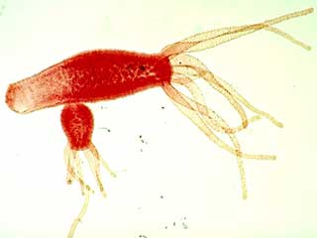
Hydra

Slide 2
 | Sexual Reproduction | Asexual Reproduction
# of parents | 2 | 1
Likeness of offspring | Look similar to parents; combination of traits | Look identical to parents; share all traits

Slide 3
Asexual Reproduction
Requires only one parent
Offspring are identical to parents (same hereditary material)
Offspring may be smaller
Uses cell division to occur (mitosis)

Slide 4
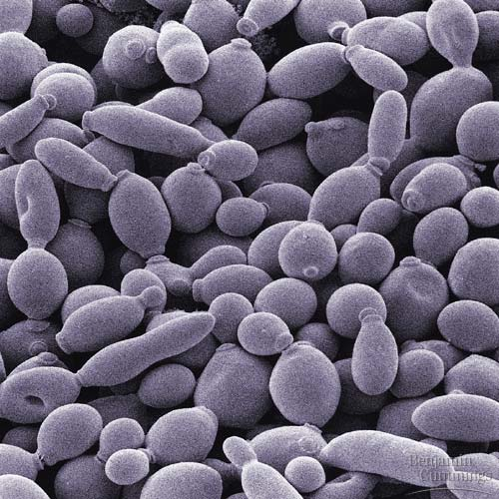
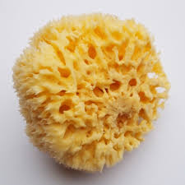
Budding
Produces offspring by a bud growing from the parent until it is big enough to break off.
Occurs in hydra and yeast.

Slide 5
https://www.youtube.com/watch?v=4JIytOL-Q18

Slide 6
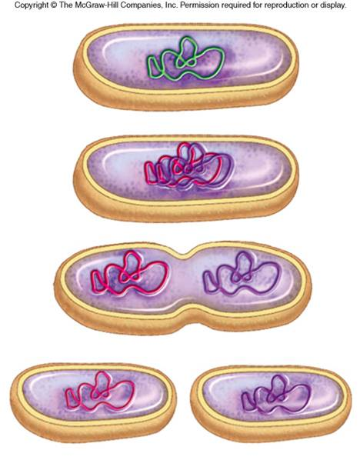
Fission
Produces offspring by the cell growing, copying hereditary material, and splitting into two identical daughter cells
Occurs in bacteria and one celled organisms

Slide 7
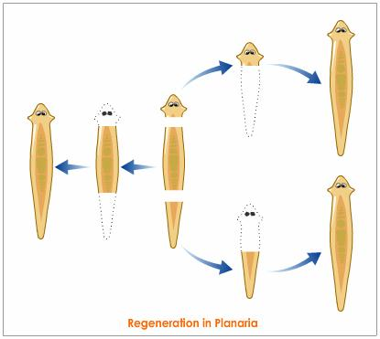
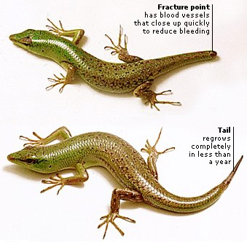
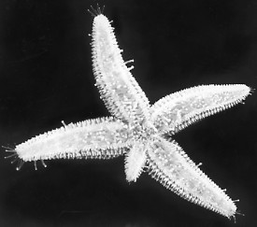
Regeneration
Ability of an organism to regrow lost or damaged body parts.
Can result in whole new organisms
Occurs in starfish, planaria, lizard’s tails, sponges

