Slide 1
The Cell Cycle

Slide 2
Why do cells divide?
For growth and repair
To get food, water, and waste in and out of our bodies quickly

Slide 3
What is the Cell Cycle?
Series of events that take place from one cell division to the next
Constantly repeated

Slide 4
Three Stages of the Cell Cycle
Interphase
Mitosis
Cytokinesis

Slide 5
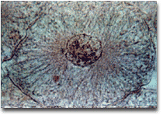
Interphase
Period of growth and development
Longest phase of the cell cycle
Some cells never leave interphase such as nerve and muscle cells

Slide 6
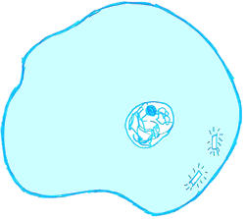
Three things happen during interphase:
Cell grows in size; makes an extra set of structures
Cell makes a copy of its hereditary material. (DNA)
Produces structures needed division (spindle fibers, centrioles)

Slide 7
DNA
Deoxyribonucleic acid
It is our hereditary material (passed on from our parents)
Found in the nucleus of our cells as chromatin

Slide 8
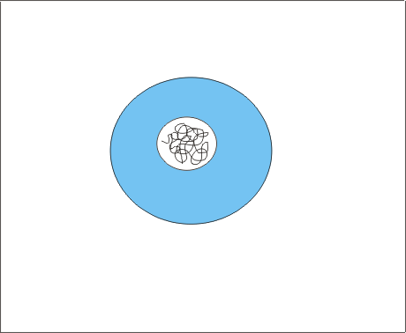
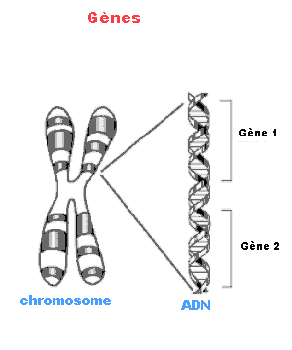
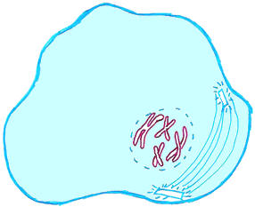
Chromatin vs. Chromosomes
Chromatin is uncoiled DNA
Chromosomes are tightly coiled strands of DNA

Slide 9
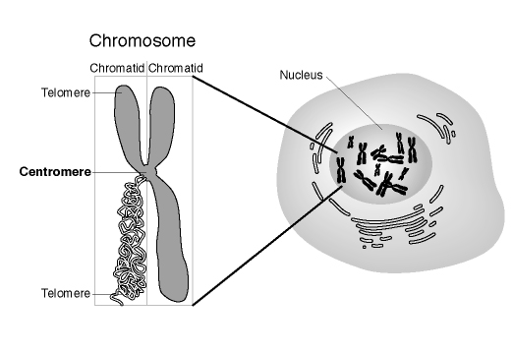
Chromosomes

Slide 10
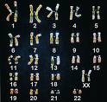
Human Karyotype

Slide 11
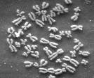
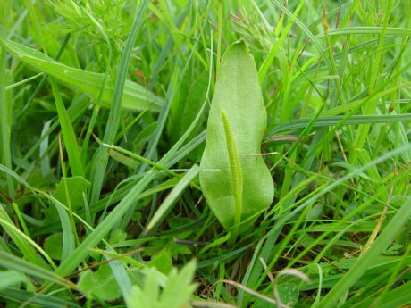
Chromosome #’s
Humans-46
Carrot-18
Cat- 32
Dog-78
Earthworm-36
Fruit fly-8
Chimpanzee-48
Adder’s tongue fern-1,262

Slide 12
Mitosis
Is the division of the nucleus
Results in two new identical nuclei

Slide 13
Four Stages of Mitosis
Prophase
Metaphase
Anaphase
Telophase

Slide 14
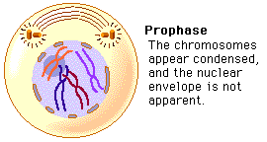
Prophase
Chromatin condenses to form chromosomes.
Centrioles move to opposite ends of the cell
Spindle fibers form bridge between the ends of the cell.
Nuclear envelope breaks down.

Slide 15
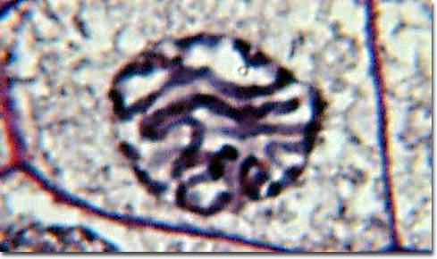

Slide 16
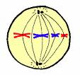
Metaphase
Chromosomes line up in the center of the cell attaching to spindle fibers by a centromere.

Slide 17
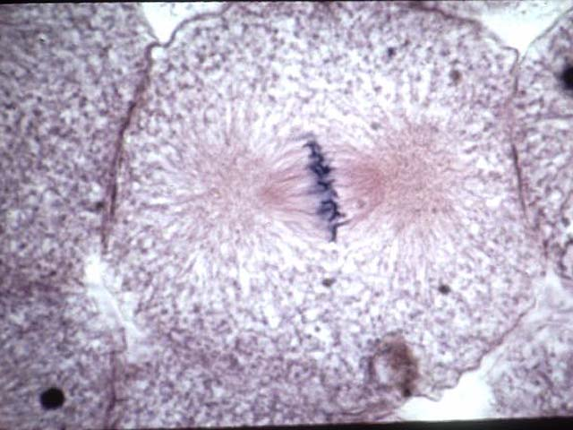

Slide 18
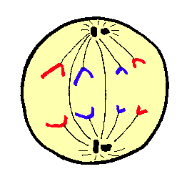
Anaphase
Centromeres split
Chromatids separate and become chromosomes.
The new chromosomes move to opposite ends of the cell
Cell begins to stretch out as the ends are pushed apart.

Slide 19
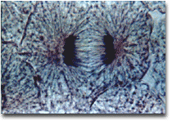

Slide 20
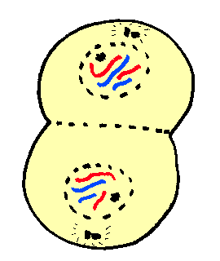
Telophase
Chromosomes stretch out
New nuclear envelope forms around each region of chromosomes

Slide 22
Cytokinesis
The cell membrane pinches in around the middle of the cell.
The cell splits in two
Each daughter cell ends up with an identical set of chromosomes and half of the organelles.

Slide 23
Cytokinesis
The division of the cytoplasm
Usually starts around the same time as telophase
Results in two new identical cells (daughter cells) that have the same # of chromosomes as the original parent cell

Slide 24
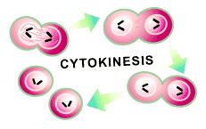
Cytokinesis in Animal Cells
Cell membrane pinches together around the middle of the cell creating two new cells
Each daughter cell gets about half of the organelles

Slide 25
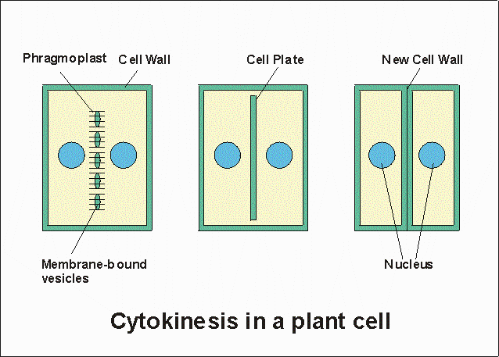
Cytokinesis in Plant cells
Cell plate forms down the center of the cell
The cell plate gradually develops into a cell membrane
New cell walls form around the cell membrane

Slide 26
http://www.youtube.com/watch?v=rgLJrvoX_qo&feature=related

Slide 28
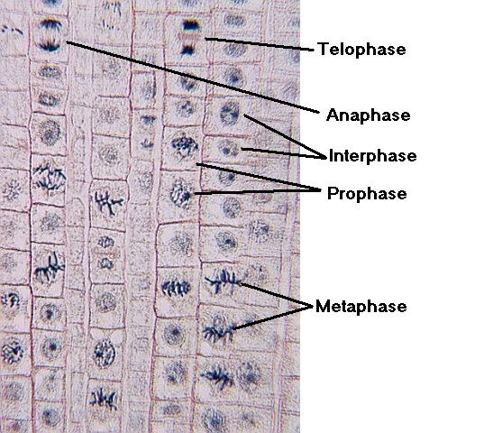
mitosis in root tip

