Slide 1
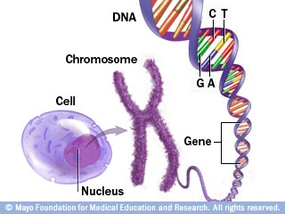
The DNA Connection

Slide 2
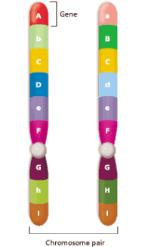
Chromosomes
Human cells contain 23 pairs of chromosomes (one from each parent)
Chromosomes are made of many different genes joined together.
Genes are sections of DNA that code for specific traits
There are approximately 35,000 genes in each human cell.
Each chromosome in a pair contains an allele for each trait.

Slide 3
Making Proteins
The main function of genes is to make proteins.
Proteins help determine the size, shape, color, and many other traits of an organism.
The sequence of bases in a gene forms a code that tells the cell what protein to make (like letters forming words)
A single gene can have up to one million bases

Slide 4
Mutations
“Mistakes” in a gene
Caused by radiation, chemicals, etc.
Can cause the gene to make the wrong protein (trait)
If it happens in a body cell, it will not be passed on.
If it happens in a sex cell, it can affect the offspring.

Slide 5
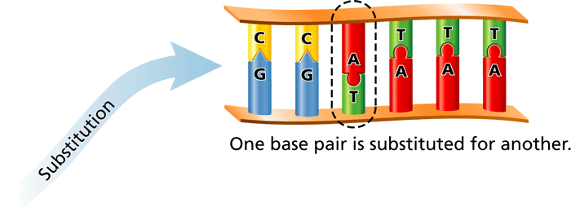
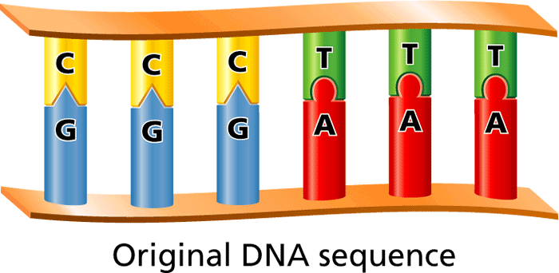
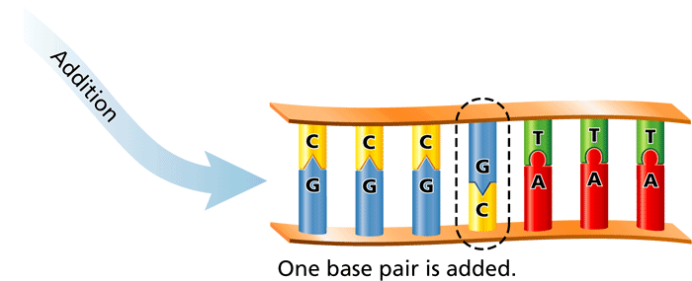
Types of Mutations

Slide 6
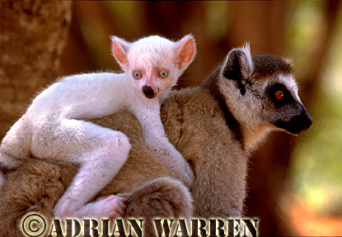
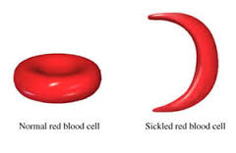
Effects of Mutations
Helpful
Enlarged wrist bone in pandas to grasp bamboo
Harmful
white lemur in the wild
Cancer and other diseases
Have no effect
Both helpful and harmful
Antibiotic resistance (helpful to bacteria, not us!)
Sickle cell anemia

