Slide 1
The Nervous System
Chapter 6

Slide 2
Functions
Receives information
Responds to information
Maintains homeostasis

Slide 3
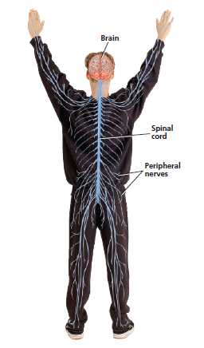
Divisions of the Nervous System
Central Nervous System
Peripheral Nervous System
Brain
Spinal Cord
Network of nerves that branch out from central nervous system
Somatic-voluntary actions
Autonomic-involuntary actions

Slide 4
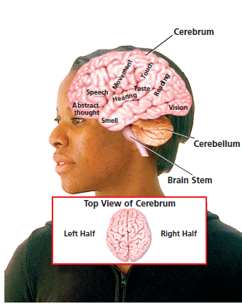
Regions of the Brain
Cerebellum- balance and coordination
Cerebrum-learning, memory
Brain Stem- involuntary actions (breathing, heart beat)

Slide 5
Nervous System Injuries
Concussions
Spinal Cord Injuries
Bruise-like injury of brain
Occurs when soft tissue collides against skull
Can cause headache, dizziness, confusion, memory loss, brain damage
Occur when spinal cord is bruised or cut
Impulses can no longer travel along axons
Can result in paralysis

Slide 6
Receiving Information
Your senses are used to receive information from the environment
Include taste, touch, smell, sight, hearing

Slide 7
Responding to Information
Stimulus- change in environment
Response-reaction to change

Slide 8
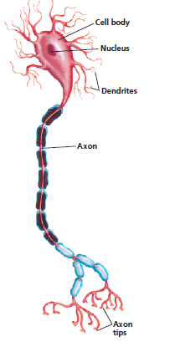
Structure of a Neuron

Slide 9
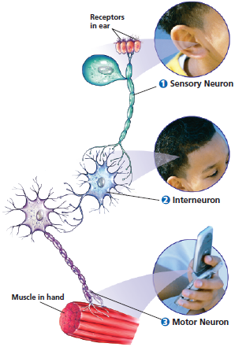
Kinds of Neurons
Sensory neuron
Interneuron
Motor neuron

Slide 10
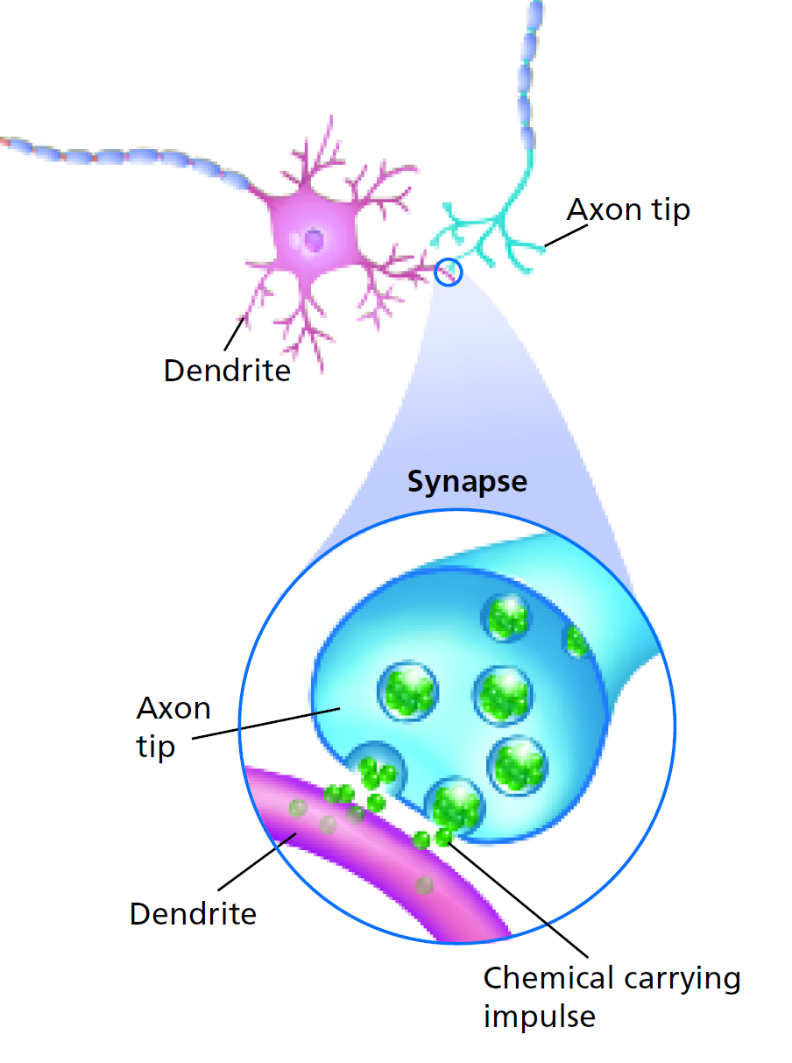
How nerve impulses travel
Travel up to 120 meters per second
Axons release chemicals to help nerve impulse travel across synapse

Slide 11
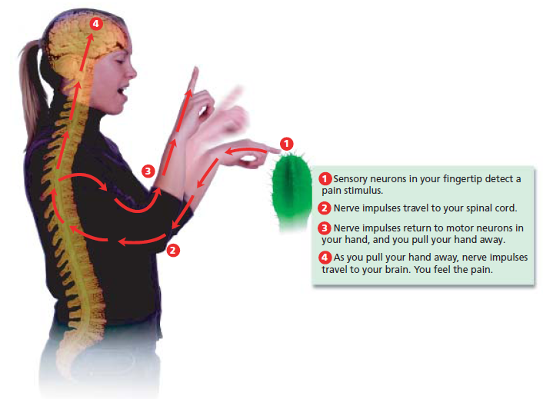
Reflexes
Automatic response that occurs rapidly and without conscious control
Helps protect your body

