Slide 1
Digestion
Chapter 2

Slide 2
What is digestion?
Process by which the body breaks down food into small nutrient molecules.

Slide 3
Jobs of the Digestive System
Breaks down food into molecules the body can use
Absorbs nutrients into the blood to be carried throughout the body
Eliminates wastes

Slide 4
Major Organs
Mouth
Esophagus
Stomach
Small intestine
Liver
Gall bladder
Pancreas
Large intestine
Rectum/anus

Slide 5
Types of Digestion
Mechanical
Chemical
Physically breaks down food into smaller pieces
Ex: chewing, peristalsis
Chemicals in the body such as enzymes and acids break foods into smaller chemical building blocks.
Ex: saliva breaks starch into sugar

Slide 6
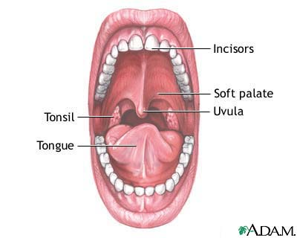
Mouth
Teeth chew food into small pieces
Saliva moistens food and mixes it with enzymes

Slide 7
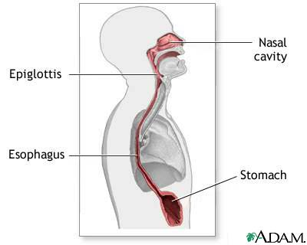
Esophagus
Tube that connects mouth to stomach
Lined with mucus to help food move to the stomach by peristalsis
Epiglottis is a flap that blocks food from going down windpipe.

Slide 8
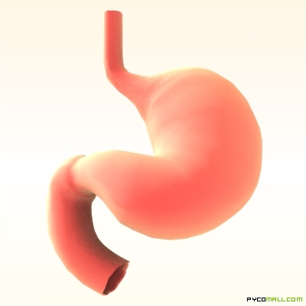
Stomach
J-shaped pouch
Mixes food with digestive juices such as enzymes and acids to turn food into liquid form(chyme).

Slide 9
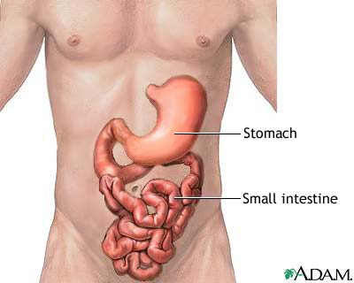
Small intestine
Mixes liquid from the stomach with enzymes and secretions from the liver and pancreas.
Lined with villi to absorb nutrients into the bloodstream
20-25 ft long!

Slide 10
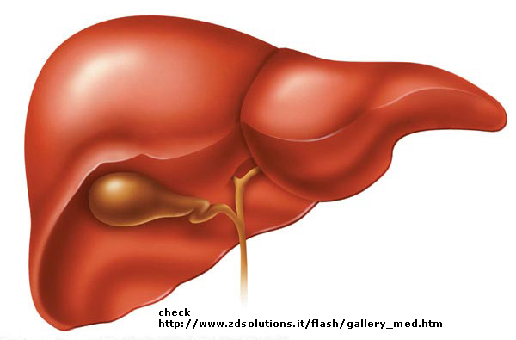
Liver and Gallbladder
Largest organ inside of body
Filters chemicals and drugs from blood
Produces bile to break up fats
Gallbladder stores the bile

Slide 11
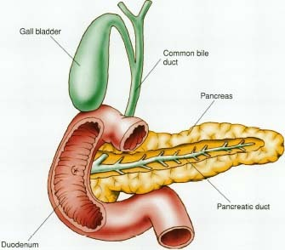
Pancreas
Triangular organ in between stomach and small intestine
Produces insulin and enzymes to break down starches, proteins, and fats

Slide 12
Large intestine
Contains helpful bacteria to help feed on digested food
Water is removed from waste and absorbed into blood
Gets waste ready for elimination from body
Only 5 ft long but wider than small intestine

Slide 13
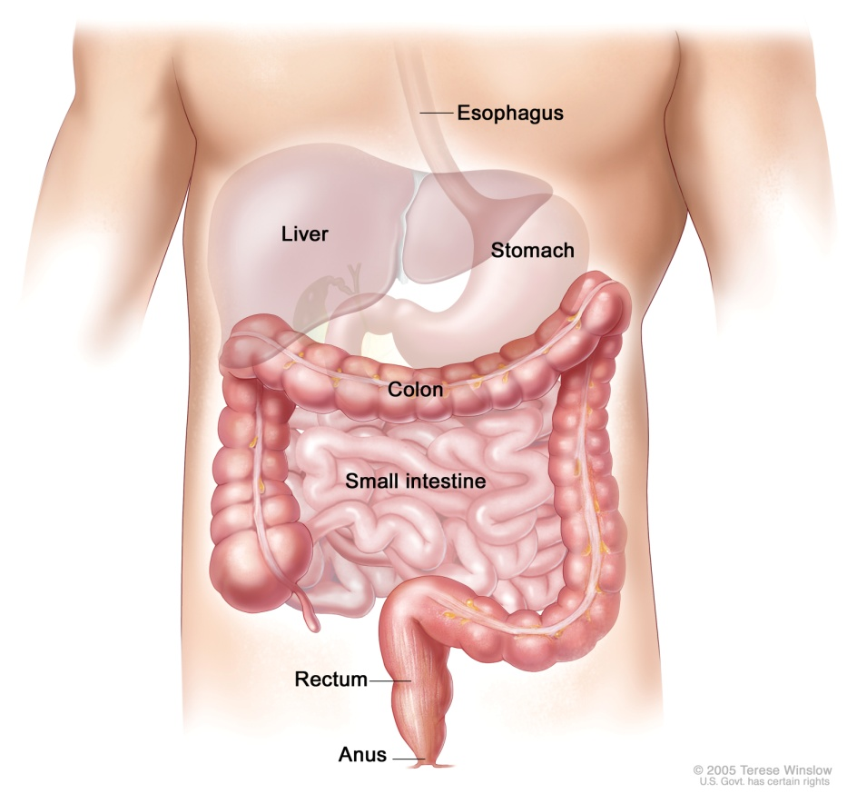
Rectum and Anus
Rectum-compresses food into solid form
Anus- muscular opening that removes waste from the body

