Slide 1
Earth in Space
Chapter 1, Section 1

Slide 2
How Earth Moves
Earth moves in two ways:
Rotation
Revolution

Slide 3
Rotation
Spinning on its axis
Takes 24 hours (day)

Slide 4
Revolution
To move around another object
Earth “orbits” around the sun
Takes 365 ¼ days (year);
Ellipse shaped

Slide 5
What causes day and night
Caused by the rotation of Earth
It is day on the side of the Earth facing the sun
It is night on the side facing away from the sun
Earth rotates eastwards causing the sun to appears to rise in the east and set in the west
Takes 24 hours for a complete day/night cycle

Slide 6
Seasons
Occur because Earth’s axis is tilted at a 23.5° angle as it revolves around the sun
Not caused by the Earth’s distance from the sun

Slide 7
Solstices
June solstice (June 21st)
North end of Earth’s axis is tilted towards the sun
Summer in the Northern Hemisphere
More hours of daylight
December solstice (December 21st)
South end of Earth’s axis is tilted towards the sun
Winter in the Northern Hemisphere
Fewer hours of daylight

Slide 8
Equinoxes
Means “equal night”
Day and night are both 12 hours long
Neither end of Earth’s axis is tilted toward the sun
March 21st= vernal (spring) equinox
September 22nd= autumnal (fall) equinox

Slide 9
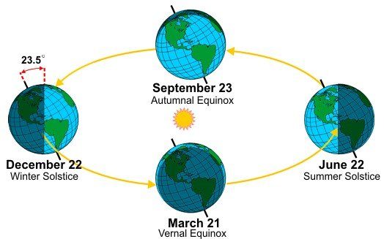

Slide 10
http://www.pearsonsuccessnet.com/snpapp/iText/products/0-13-181247-5/video.html?fname=video/video_sx05_jcv011b.mov

