Slide 1
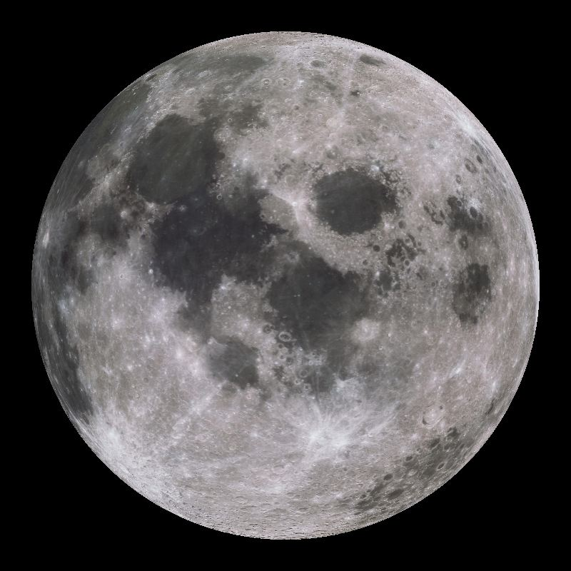
The Moon

Slide 2
Moons Surface
First seen up close with a telescope by Galileo in 1609
Covered with craters, mountains, and maria
Dry and airless (no atmosphere like us)
Temperatures range from -180°C to 130°C

Slide 3
Moon Motions
Rotates once on its axis every 27.3 days
Revolves around the Earth once every 27.3 days
Day and a year are the same length of time on the moon!
The same side of the moon always faces Earth
As the moon revolves around the Earth, the relative positions of the Earth, moon, and sun cause the phases of the moon, eclipses, and tides.

Slide 5
Moon Phases
Different shapes of the moon
Determined by how much of the sunlit side of the moon can be seen from Earth.
One side of the moon is always lit up.
8 phases
Takes about one month (29.5 days) to go through all of the phases.

Slide 6
Moon Phase Vocabulary
Illuminated-lit up
Crescent- less than half lit up
Gibbous- more than half lit up
Waning-getting less lit up
Waxing-getting more lit up
1st Quarter-half lit up on right (1st base)
3rd Quarter-half lit up on left (3rd base)

Slide 8
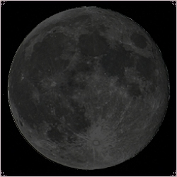
New Moon

Slide 9
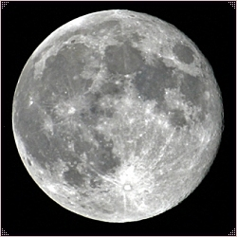
Full Moon

Slide 10
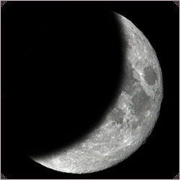
Waxing Crescent

Slide 11
Waxing Gibbous

Slide 12
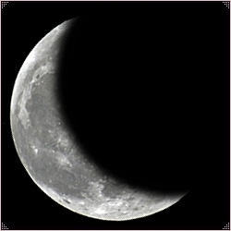
Waning Crescent

Slide 13
1st Quarter

Slide 14
Waning Gibbous

Slide 15
3rd Quarter

