Slide 1
Properties of Liquids

Slide 2
Surface Tension
Result of an inward pull among the molecules of a liquid that brings the molecules on the surface closer together
Water forms droplets and can bead up on surfaces
Strong attractions between water molecules cause molecules at the surface to be pulled slightly toward the molecules beneath the surface
Due to surface tension, the surface of water can act like skin
Ex: needle floating on water
Ex: Water strider walking on water

Slide 3
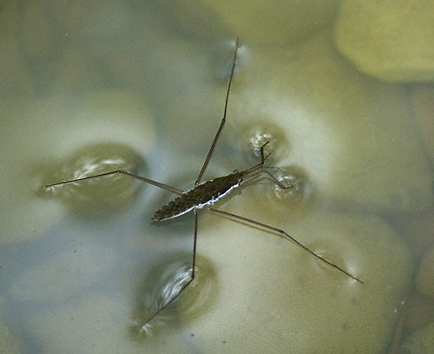
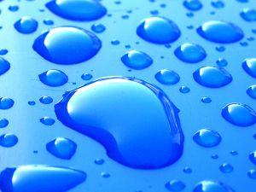
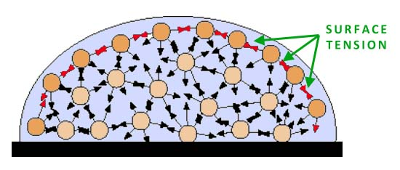

Slide 7
Viscosity
A liquid’s resistance to flow
Depends on size and shape of particles and the attractions between the particles
Liquids with high viscosity flow slowly
Ex: honey
Liquids with low viscosity flow quickly
Ex: water, vinegar

Slide 8
