Slide 1
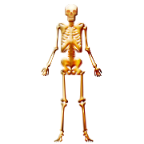
Skeletal System

Slide 2
Skeletal Functions
Provides shape and support.
Enables us to move.
Protects your internal organs.
Produces blood cells.
Stores minerals such as calcium and phosphorous.

Slide 3
Bone Formation and Growth
As a baby, most of your skeletal system is made up of cartilage.
Cartilage is broken down and replaced with calcium and phosphorous to make hard bone
Babies have over 300 bones
Adults only have 206 bones because they fuse together as you get older.
Bones are continuously being formed and reformed as they are worn down or broken.

Slide 4
Bone Structure
Bones are lightweight yet very strong.
They can absorb more force than concrete, granite, or steel.

Slide 5
Parts of a Bone
Outer membrane (periosteum)-where nerve and blood vessels enter and leave the bone
Compact bone- makes bones hard, strong, and flexible
Spongy bone- contains small spaces to make bones lightweight.
Marrow-produces blood cells and stores fat
Cartilage- flexible connective tissue at the ends of bones that help absorb shock and reduce friction.

Slide 6
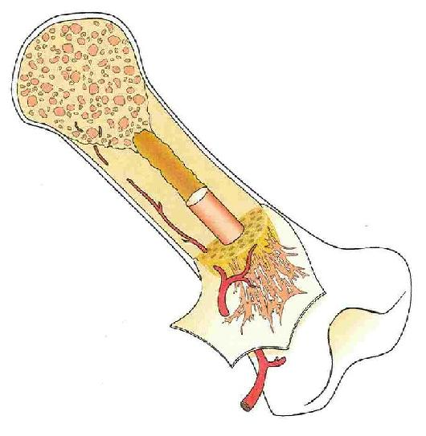
Spongy bone
marrow
compact bone
periosteum
cartilage

Slide 7
Joints
Places where two bones meet.
Held together by ligaments, which are strong bands of connective tissues
Two types
Immovable (Fixed)
Movable

Slide 8
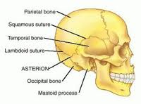
Immovable
Allows little or no movement
Ex: skull, pelvis

Slide 9
Movable Joint
Allow wide range of movement
Four types:
Hinge
Pivot
Ball and Socket
Gliding

Slide 10
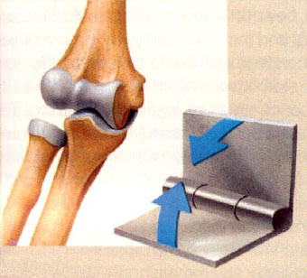
Hinge Joint
Back and forth movement
Ex: knee and elbow

Slide 11
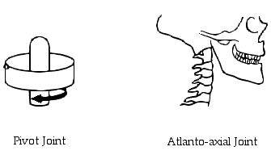
Pivot Joint
One bone rotates around another
Ex: neck/head

Slide 12
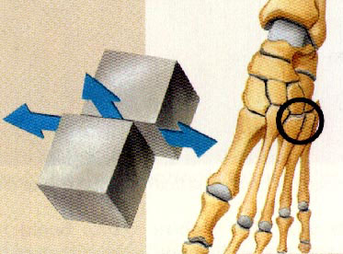
Gliding Joint
One bone slides over another
Ex: Wrist, ankle

Slide 13
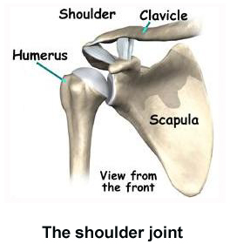
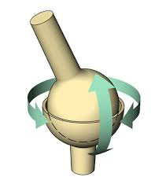
Ball and Socket Joint
Circular motion
Ex: hip, shoulder

Slide 14
Joint animation

Slide 16
Taking care of your bones
Well balanced diet of foods rich in calcium and phosphorous (dairy, meats, whole grains, and leafy green vegetables)
Exercise
Stretching
Wear protective gear (helmets, pads)

Slide 17
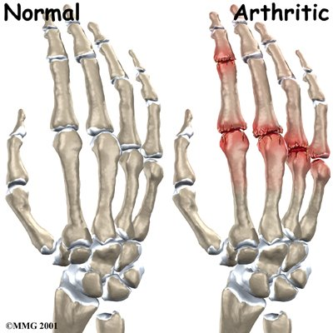
Arthritis
Means “joint inflammation”
Cartilage between joints worn away due to excessive use
Often occurs in elderly and athletes

Slide 18
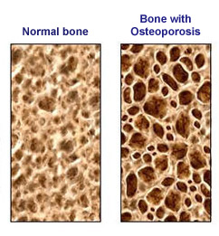
Osteoporosis
Osteoporosis-condition in which bones become brittle and weak due to mineral loss (calcium)

Slide 19
Bone Injuries
Fractures
Dislocation
Sprains

Slide 20
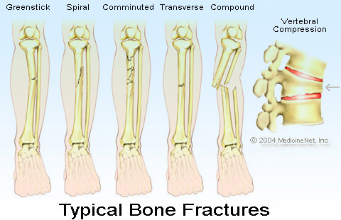

Slide 21
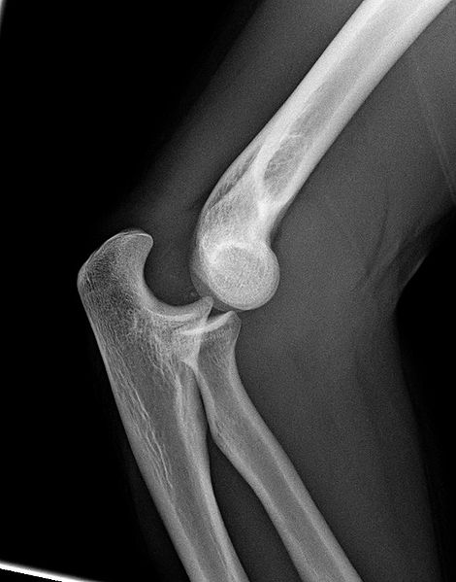
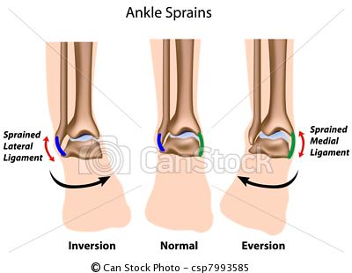

Slide 22
Diagnosing Bone Injuries
X-rays
MRI

Slide 23
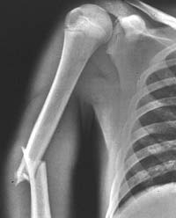
X-rays
Bones absorb x-rays and reflect image onto photographic film
Used for bone injuries (breaks, dislocations)
Provides clear images
Can damage cells
Cannot see soft tissue (muscle, organs)

Slide 24
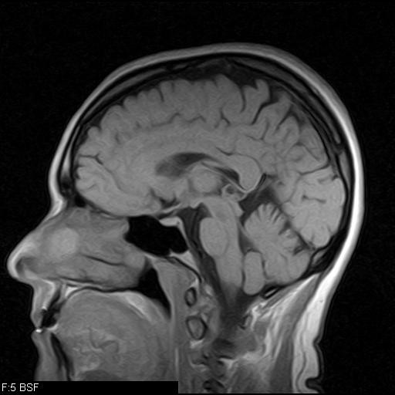
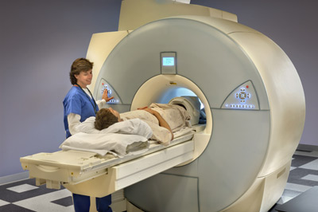
MRI
Magnetic energy causes atoms in body to vibrate producing an image for the computer to analyze.
Used for bone and soft tissue injuries
Expensive

Slide 25
Treating Bone Injuries
Cast
Joint replacement
Arthroscopy

Slide 26
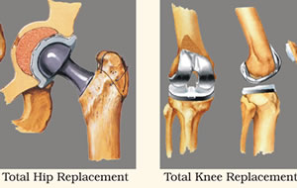
Joint replacement
When a natural joint is removed and an artificial one is cemented in its place.
Used for knees, hips, shoulders, fingers, and wrists

Slide 27
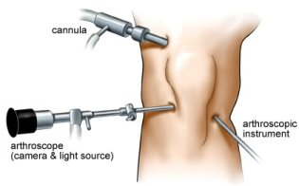
Arthroscopy
Thin, tube like instrument called an arthroscope is inserted through a small incision
A camera at the end of the scope allows doctor to examine the problem
Attached instruments can fix the injury

Slide 28
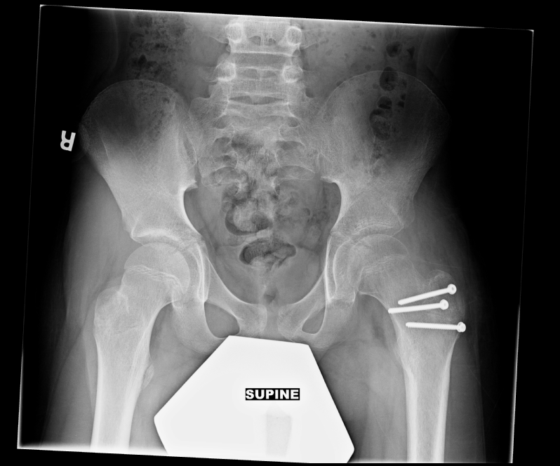
Notes:
Domenic Schiavo

