Slide 1
States of Matter
Chapter 2-1

Slide 2
What are the three main states of matter?
Solid
Liquid
Gas

Slide 3
Why are there different states of matter?
Depends on how their particles are arranged and how they move

Slide 4
What causes particles to move?
Particles move due to kinetic energy
Amount of kinetic energy is measured by temperature
The greater the temperature, the faster the particles
Particles stop moving at absolute zero (-273.15°C)

Slide 5
Solids
Definite shape
Definite volume
Particles packed very close together
Low kinetic energy
Particles vibrate slowly in place
Can be crystalline or amorphous

Slide 6
Liquids
No shape of its own (takes shape of it’s container)
Definite volume
Particles are packed somewhat close but can move freely (fluid)
Moderate kinetic energy
Particles move at a moderate speed

Slide 7
Gases
No definite shape
Changes volume
Particles are spread apart (Fill all the space available to them)
High kinetic energy
Particles move quickly
Fluid

Slide 8
Changes of State
A substance changes states when energy levels increase or decrease significantly by the addition or removal of heat.
As temperature increases, energy levels increase.
As temperature decreases, energy levels decrease.

Slide 9
Changes between a Solid and Liquid
Melting
change in state from a solid to a liquid
added thermal energy (heat) makes water molecules vibrate faster causing them to break free from their fixed position.
melting point of water = 0°C
Freezing
change in state from a liquid to a solid
Water loses energy to the cold air and moves more slowly until it turns to solid ice
freezing point of water = 0°C

Slide 10
Changes Between Liquids and Gases
Condensation
occurs when particles of a gas lose enough thermal energy to change back into a liquid
Vaporization (boiling/evaporation)
occurs when the particles in a liquid gain enough thermal energy to form a gas.

Slide 12
Two Types of Vaporization
Evaporation
takes place only on the surface of a liquid
Water gains energy from ground, air, or sun
Boiling
liquid turns to a gas below the surface and at the surface; forms bubbles throughout
boiling point of water = 100°C (at sea level)

Slide 13
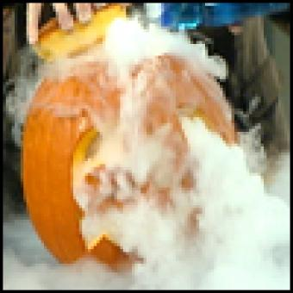
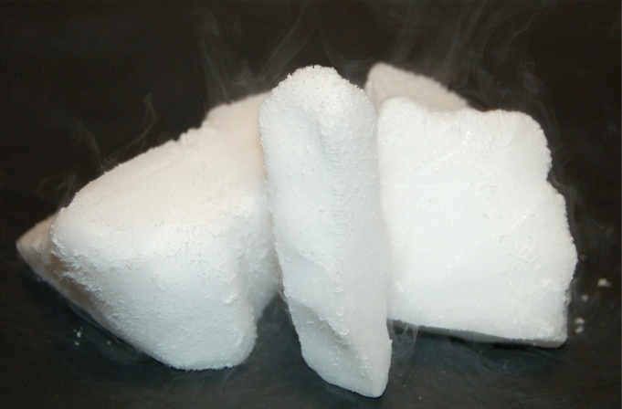
Changes between a solid and gas
Sublimation
Particles of a solid gain enough energy to form directly into a gas without forming a liquid first
Example: dry ice

Slide 14
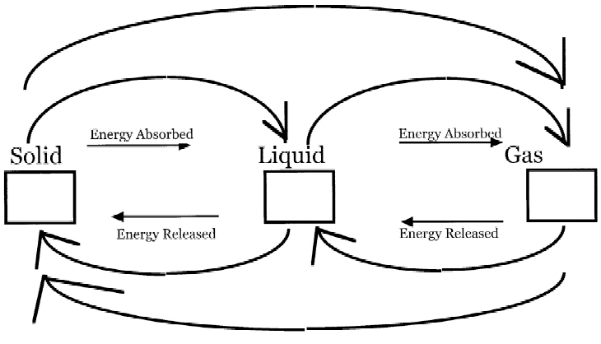
Phase Changes
Sublimation
Melting
Boiling/Evaporating
Temp increased
Temp increased
Water Vapor
Ice
Temp decreased
Water
Temp decreased
Freezing
Condensing

Slide 15
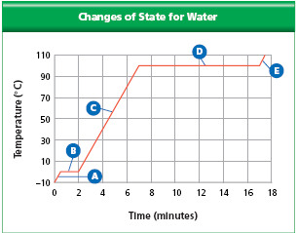
Phase Change Diagram

