Slide 1
Eclipses
Occur when the moon’s shadow hits Earth or Earth’s shadow hits the moon.
Only occurs when the Earth, moon, and sun are lined up exactly.

Slide 2
Solar Eclipse
Occurs when moon passes directly between the Earth and the sun.
Occurs during a new moon
Turns as dark as night; can see stars
Dangerous to look at
Only can be seen from a small area on Earth
Total solar eclipse last a few minutes

Slide 3
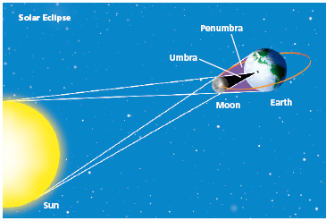
Solar Eclipses

Slide 4
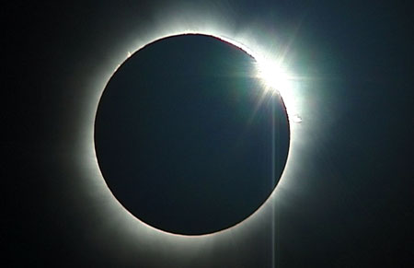
How a solar eclipse looks from Earth

Slide 5
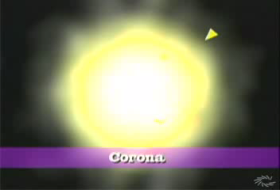
Solar Eclipses

Slide 6
Lunar Eclipse
Occurs when Earth is directly between the moon and the sun
Occurs during a full moon
More likely to be seen
Total lunar eclipse lasts 2-3 hours

Slide 7
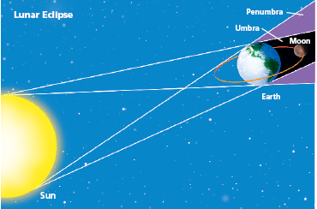
Lunar Eclipse

Slide 8
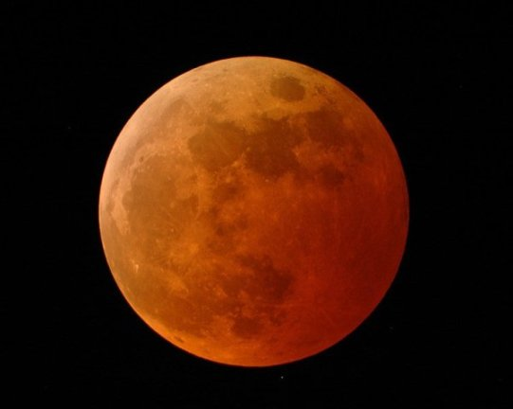
How a lunar eclipse looks from Earth

Slide 10
Total vs. Partial
Total Eclipses
Partial Eclipses
The moon or Earth’s umbra completely blocks out sunlight
The moon or Earth’s penumbra blocks some sunlight

Slide 11
https://youtu.be/rVE8PFYlwSM

