Slide 1
What is a tide?
The rise and fall of ocean water every 12.5 hours.
Caused by differences in how much the moon’s gravity pulls on different parts of the Earth.
Each location on Earth has 2 high tides and 2 low tides every 25 hours or so.
As the Earth rotates, one high tide stays on the side of Earth facing the moon and one stays on the opposite side

Slide 2
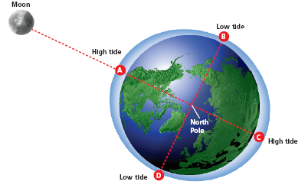

Slide 5
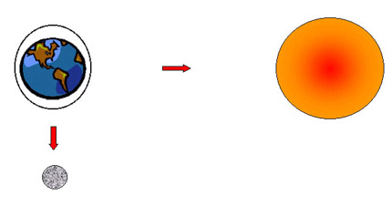
Spring Tides
Neap Tides
Occurs 2x per month (new and full moon phases)
Occurs when the Earth, moon, and sun line up
Greatest difference between consecutive high and low tides (really high high tides and really low low tides)
Occurs 2x per month (1st and 3rd quarter phases)
Occurs when the Earth and sun line up at a right angle to the moon.
Least difference between high and low tides

