Slide 1
Human Genetics

Slide 2
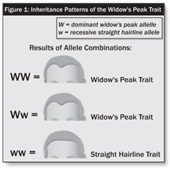
Patterns of Human Inheritance
Many human traits are controlled by a single gene with two alleles as was seen with Mendel’s experiments.
Ex: widow’s peak, dimples, cleft chins, curly hair.
Other traits such as blood type and height may be controlled by many different genes or alleles.

Slide 3
Multiple Alleles
Three or more forms of a gene (alleles) that code for a single trait.
Ex: Blood types.
A and B are codominant to each other and dominant to O
Blood Type | Genotypes
A | I^{A}I^{A} , I^{A}i
B | I^{B}I^{B} , I^{B}i
AB | I^{A}I^{B}
O | ii

Slide 4
Polygenic Traits
Traits that are controlled by more than one gene.
Can have an additive effect.
Ex: Height in humans, skin color, eye color

Slide 5
Eye Color
3 known genes: Brown, blue, green
Brown is dominant to both green and blue
Green is dominant blue
Blue is recessive
Does not explain hazel, gray, etc.

Slide 6
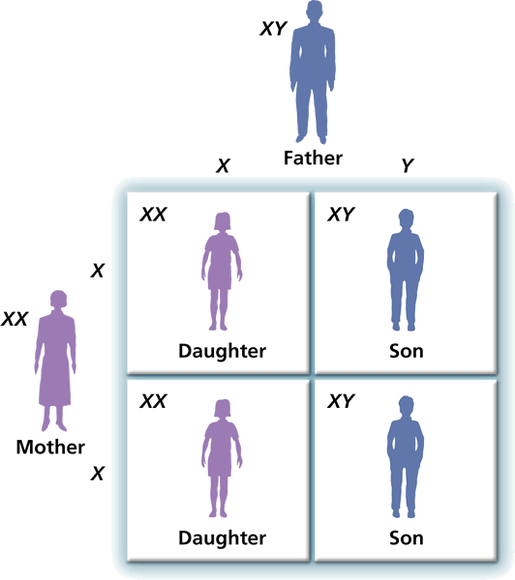
Sex Chromosomes
The sex chromosomes carry genes that determine whether a person is male or female.

Slide 7
Sex Linked Genes
Genes that are found on the sex chromosomes (X or Y).
Can cause genetic disorders such as color blindness and hemophilia.
More common in males because they have only one X chromosome.
For recessive traits, males only need one recessive allele to display the disease. Females have a second allele that could possibly mask it.

Slide 8
Color Blindness
Red-green colorblindness is a sex-linked trait.
A girl who receives only one recessive allele for red-green colorblindness will not have the trait.
However, a boy who receives one recessive allele will be colorblind.

Slide 9
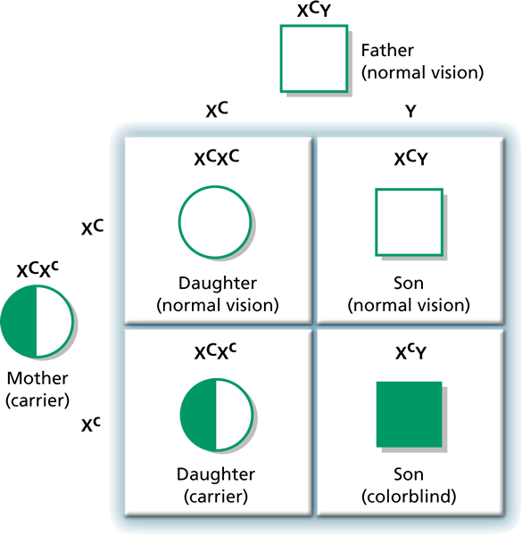
Color Blindness

Slide 10
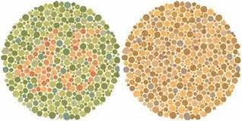
Color Blindness Test

Slide 11
The Effect of the Environment
Outside factors such as diet and experience can influence traits.
Ex: A diet that is lacking in certain nutrients could prevent a person from being as tall as they could
Ex: A musician or athlete that does not practice will not be as good as they could be.

