Slide 1
Matter What is Matter?
Anything that takes up space and has mass
Made up of atoms or molecules
Exists as three states(solid, liquid, gas)
**plasma as fourth state

Slide 2
Why are there different states of matter?
Depends on how their atoms are arranged and how they move

Slide 3
Solids: particles are tightly packed and move slowly
Liquids: particles are held together, but not in a fixed position; particles move at a moderate speed
Gases: particles are spread apart and move quickly

Slide 4
Kinetic Theory of Matter
All particles of matter are in constant random motion (Brownian motion)
Particles move due to kinetic energy
Amount of kinetic energy is measured by temperature
The greater the temperature, the faster the particles
Particles stop moving at absolute zero (-273.15°C)

Slide 5
Difference between heat and temperature
Heat is the transfer of energy from higher temperatures to lower temperatures
Ex: An ice cube melts in your hand because the energy from your hand is transferred to the ice cube

Slide 6
Solids
Definite or fixed shape
Definite volume
Particles are arranged closely together
Low kinetic energy; particles move slowly
Can be crystalline or non-crystalline (amorphous)

Slide 7
Liquids
Definite volume
Takes shape of it’s container
Particles are held together but not in a fixed shape
Fluid-flows freely
Moderate kinetic energy; particles move at a moderate speed

Slide 8
Gases
Fluid
Changes volume
No definite shape
Particles are far apart
Particles spread out until they hit a barrier
High kinetic energy; molecules are moving quickly

Slide 9
Solids
Crystalline
Non-crystalline
Particles are arranged in repeating geometric patterns
Geometry of the crystals depends on size and number of particles
Crystals are usually not very large
Examples include: diamonds, salt, sugar, snow
Crystal structures break down when melted
Definite melting point
Also called amorphous
Have no definite pattern or form
Large molecules are stuck in a random arrangement
Examples include: glass, plastic
No definite melting point; just get softer and softer

Slide 10
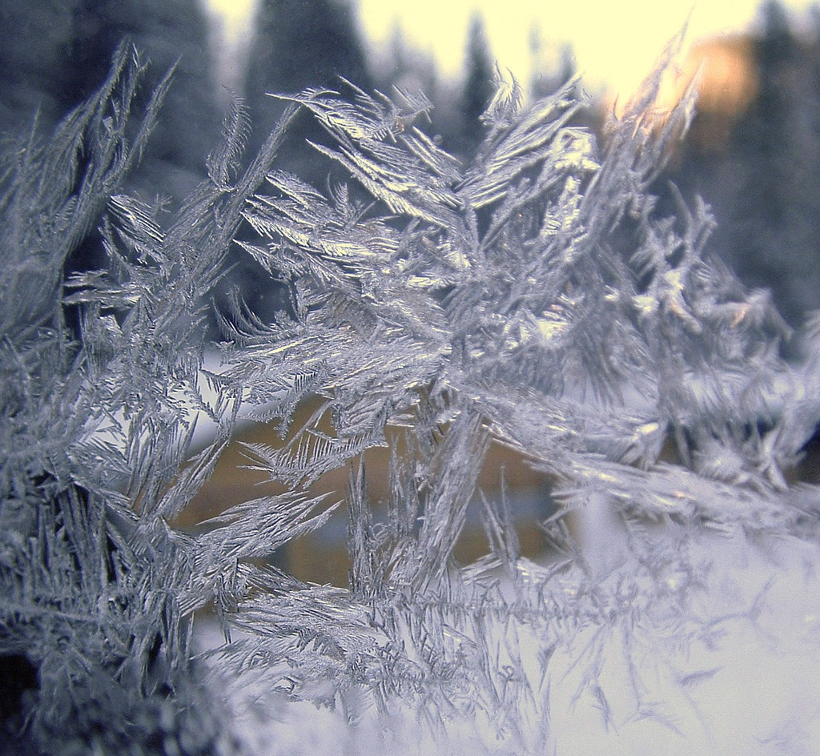
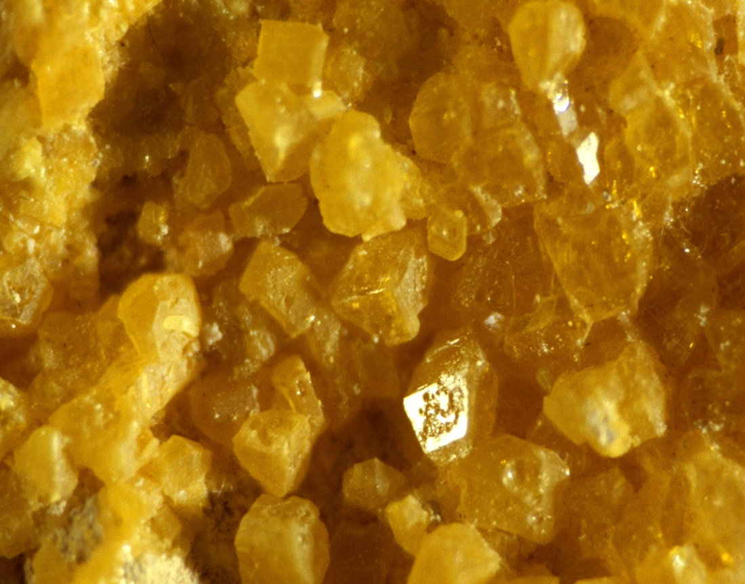
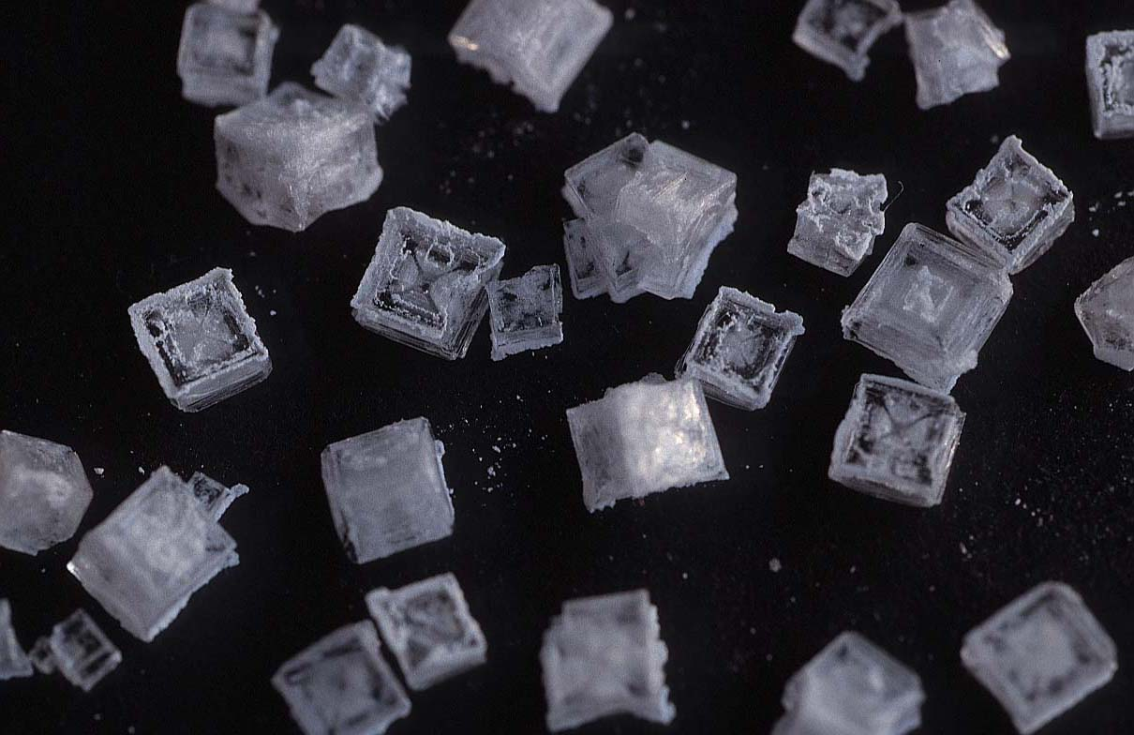

Slide 11
Phase Changes
Sublimation
Melting
Boiling/Evaporating
Temp increased
Temp increased
Water Vapor
Ice
Temp decreased
Water
Temp decreased
Freezing
Condensing

Slide 12
Changes of State
A substance changes states when energy levels increase or decrease significantly by the addition or removal of heat.
As temperature increases, energy levels increase.
As temperature decreases, energy levels decrease.

Slide 13
Changes between a Solid and Liquid
Melting
change in state from a solid to a liquid
added thermal energy (heat) makes water molecules vibrate faster causing them to break free from their fixed position.
melting point of water = 0°C
Freezing
change in state from a liquid to a solid
removal of heat causes water molecules to slow down and form into a fixed position.
freezing point of water = 0°C

Slide 14
Changes Between Liquids and Gases
Condensation
occurs when particles of a gas lose enough thermal energy to change back into a liquid
Vaporization (boiling/evaporation)
occurs when the particles in a liquid gain enough thermal energy to form a gas.

Slide 16
Two Types of Vaporization
Evaporation
takes place only on the surface of a liquid
Water gains energy from ground, air, or sun
Boiling
liquid turns to a gas below the surface and at the surface; forms bubbles throughout
boiling point of water = 100°C (at sea level)

Slide 17
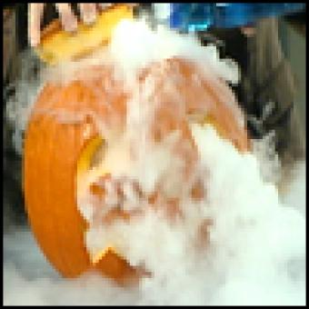
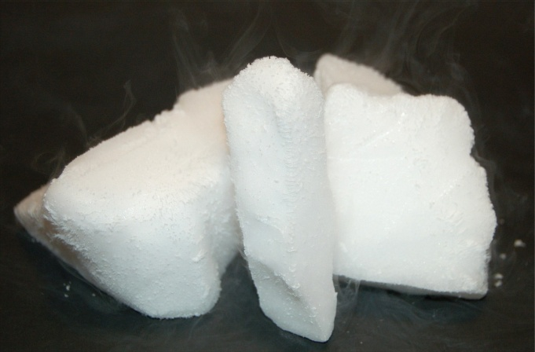
Changes between a solid and gas
Sublimation
Particles of a solid gain enough energy to form directly into a gas without forming a liquid first
Example: dry ice

Slide 18
Phase Change Diagram

