Slide 1
¡hola!
bonjour!
Foreign Language
Open house 2014
¡bienvenidos!
bienvenue!

Slide 2
Español

Slide 3
6th grade
Spanish alphabet
numbers
Greeting and goodbyes
Weather
Days of the week/months/ seasons
Likes and dislikes
Foods
Adjectives to describe yourself
Colors
8th grade
Describe a house/household items/furniture
Planning a party
Doing chores/ commands
Sports
Vacation plans
Parts of the body
Sending e-mails
Describe a past event
Make phone calls
Places of interest
Daily routines
Leisure activities
7th grade
Review: Alphabet, Numbers, Greetings, Dates
Express likes and dislikes
Describe ourselves and others
Tell time
Talk about daily schedules
Talk about where things are located
Express emotion
Say where you are going
Talk about food
Ask questions
Describe your family
Make comparisons
Describe clothing

Slide 4
Français

Slide 5
8th grade
Review of 7th grade
Describing people and objects
Colors
Adjectives
Around the city
Household rooms and objects
Activities around town
Describing your family
Clothing
Shopping
Describe an event in the past tense
6th grade
French alphabet
Numbers
Personal information (name, age, nationality)
Describing family members personal information
Express feelings/ emotion
Greetings and salutations
7th grade
Review 6th grade
Ordering food and beverages
Prices
Time, days, and date
Weather expressions
Activities
Likes and dislikes
Questions

Slide 6
Foreign Language Class: Supplies
All students are encouraged to have a BINDER dedicated to French/Spanish

Slide 7
HOMEWORK
EVERY NIGHT homework is to look over class notes and/or study vocabulary
Visit www.classzone.com for extra practice activities that follow along with the textbook!

Slide 8
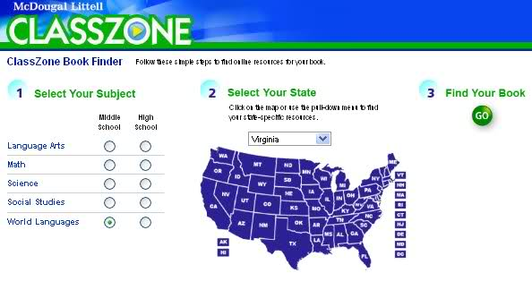
Online resources
www.classzone.com is a website where students can find interactive activities, flashcards and games. We encourage students to use this as a way to prepare for quizzes and tests at home!
www.quizlet.com is a great way to practice vocabulary with online flashcards!
We will be showing students how to access both websites in class!

Slide 9
iParent/Grades
We encourage you to use iParent in order to keep track of grades and assignments
To find out more about accessing your student’s grades online, visit the district website and see the “iParent Information” page
All Foreign Language class use the following grading percentages:
Participation/Preparation | 15%
Communicative Activities | 20%
Quizzes | 30%
Tests/Projects | 35%

Slide 10
We are all looking forward to a great year. Please contact us via e-mail with any questions or concerns. ¡Gracias! Merci!
dcastillo@norwood.k12.ma.us
jeforrest@norwood.k12.ma.us
clyons@norwood.k12.ma.us
ejones@norwood.k12.ma.us

