Slide 1
The Immune System

Slide 2
Function
To protect the body from infection or disease
Can be infectious or noninfectious

Slide 3
Infectious Disease
Disease caused by pathogens (bacteria, viruses, fungi, protists)

Slide 4
How pathogens are spread
Infected people
Soil, food, and water
Contaminated objects
Infected animals

Slide 5
Lines of Defense Against Pathogens
Barriers
Inflammatory response
Immune response

Slide 6
Barriers against pathogens
Skin
Breathing Passages
Mouth
Stomach

Slide 7
Inflammatory Response
Swelling- Blood rushes to infected area; fluid and white blood cells leak from blood vessels
Fever- high temperatures kill pathogens

Slide 8
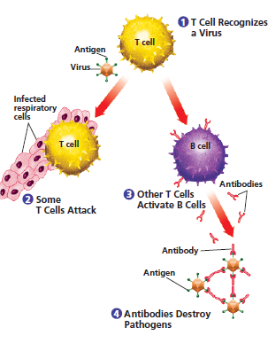
Immune response
T-cells and B-cells work together to fight off infection.

Slide 9
http://phschool.com/webcodes10/index.cfm?wcprefix=cep&wcsuffix=4052&area=view&x=8&y=22

Slide 10
Preventing Infectious Disease
Active Immunity
Passive Immunity

Slide 11
Active Immunity
Immune Response- T-cells and B-cells “remember” the pathogen and start to fight it off immediately
Vaccinations
Notes:
Chicken pox example

Slide 12
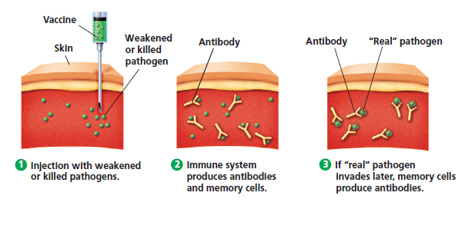

Slide 13
Passive immunity
Antibodies given from mother to baby.
Only last a few months

Slide 14
Treating Infections
Antibiotics- bacterial infections
Medications for symptoms
Rest
Fluids

Slide 15
http://kidshealth.org/PageManager.jsp?lic=1&article_set=59296&cat_id=20607

