Slide 1
Respiration

Slide 2
Function
Take in oxygen needed to turn glucose into energy
Remove waste (water and carbon dioxide)
Done by breathing

Slide 3
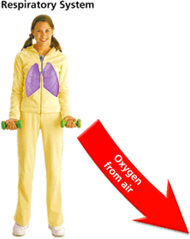
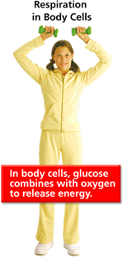
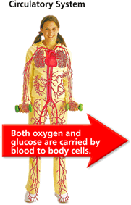
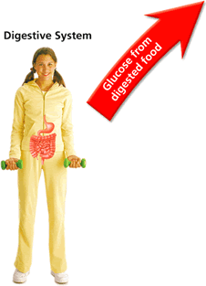
Systems Working Together

Slide 4
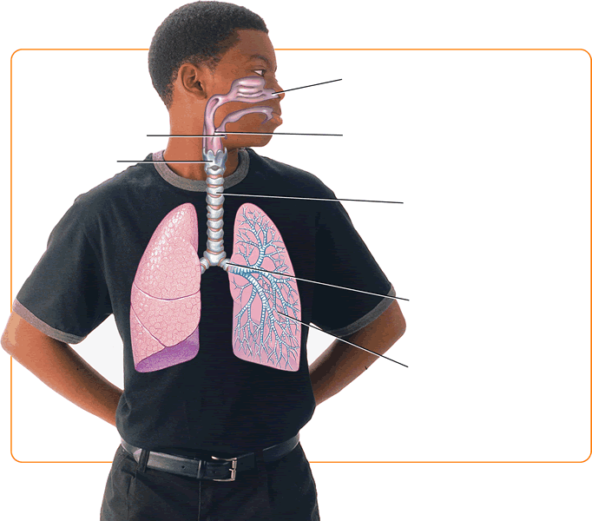
The Path of Air

Slide 5
Gas Exchange
Alveolus and capillaries are very thin.
This allows materials such as oxygen, carbon dioxide, and water to easily pass through them by diffusion.
Your lungs have a large surface area of alveoli that enables them to absorb a lot of oxygen.

Slide 6
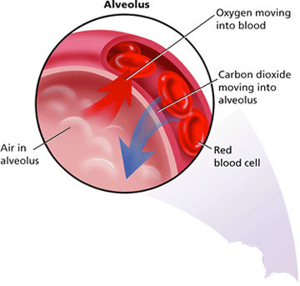
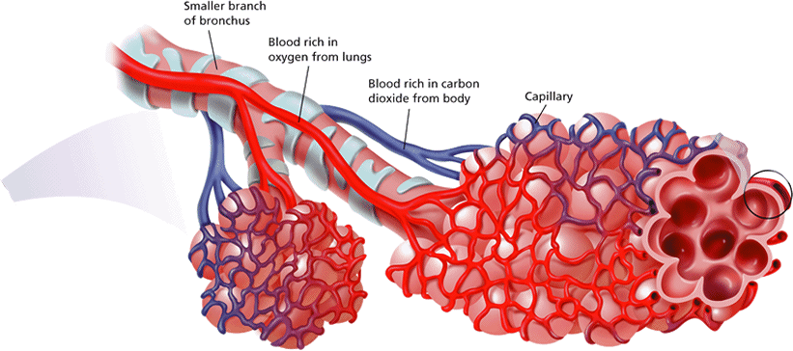
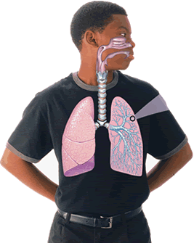

Slide 7
Breathing
Inhalation- “Breathing in”
Exhalation- “Breathing out”
Rib muscles contract lifting the chest wall upwards.
Diaphragm contracts and moves downward.
Pressure inside lungs decreases and fills with air
Rib muscles relax.
Diaphragm relaxes.
Pressure inside lungs increases pushing air out

Slide 8
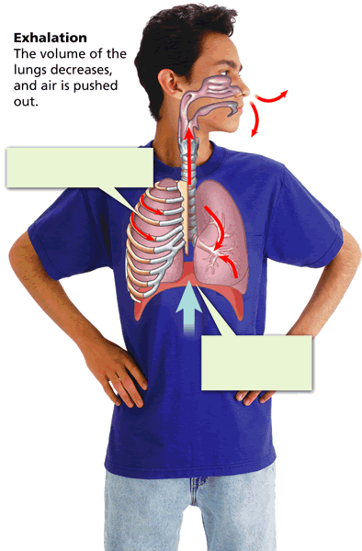

Slide 9
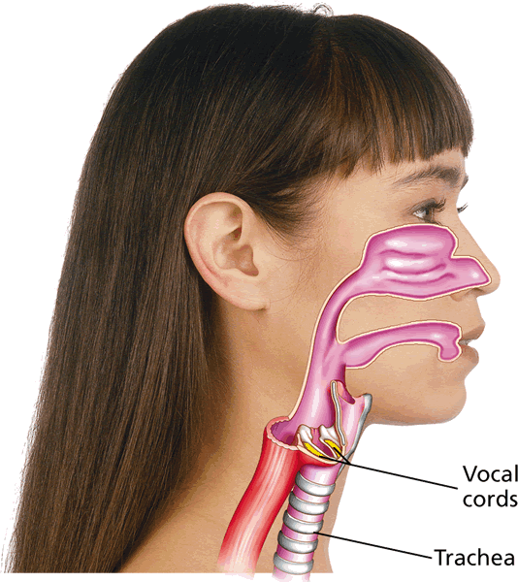
Sound
As air moves across the larynx, or voice box, the vocal cords vibrate to make sound.

Slide 10
Respiratory Diseases
Chronic Bronchitis- irritation of breathing passages causing them to be narrower and clogged with mucus.
Emphysema-severe damage to lung tissue that causes breathing difficulties.
Lung Cancer-tumors take away space in lungs that is used for gas exchange
****All caused by smoking

Slide 11
