Slide 1
Body Organization and Homeostasis
Chapter 1 Section 1

Slide 3
Put the following levels of body organization into order from smallest to largest
Cell, organ, organ system, tissue
Organ, organ system, tissue, cell
Cell, tissue, organ, organ system
Organ system, organ, tissue, cell

Slide 4
Body Organization
Cells
Tissues
Organs
Organ System

Slide 5
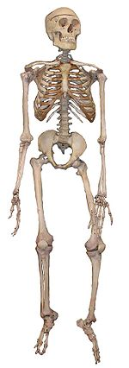
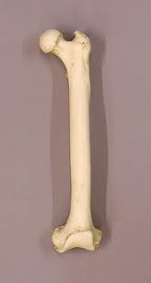
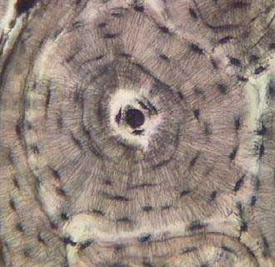
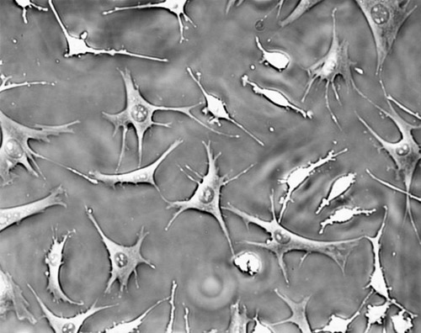
Example
Bone Cells
Connective Tissue
Femur
Skeletal System

Slide 6
Cells
Basic unit of structure and function in a living thing
Skin cells
Neurons (nerve) cells
Blood cells
Bone cells
Muscle cells
Stem cells

Slide 7
Tissues
Groups of similar cells that perform a similar function.
Types:
Muscle tissue- contracts to allow movement
Nervous tissue- carries messages back and forth from the brain to the rest of the body
Connective tissue- connects and supports the body (bone, fat, blood)
Epithelial- covers the surface of your body and lines your internal organs (skin)

Slide 8
Organs
Structures that are composed of different types of tissue to perform a specific job.
Examples:
Heart
lungs
Kidneys
Bladder
Stomach
Brain
Pancreas
Gall bladder
Skin

Slide 9
Organ Systems
Group of organs that work together to perform a major function.
Examples
Skeletal
Muscular
Circulatory
Digestive
Nervous
Respiratory
Excretory
Immune
Integumentary
Reproductive

Slide 10
Homeostasis
Process by which an organism keeps an internal balance.
Ex: Shivering and sweating to maintain body temperature
Can be disrupted by stress.
Ex: When you are nervous, your heart beats faster.

