Slide 1
Describing Matter

Slide 2
What is Chemistry?
The study of the properties of matter and how matter changes

Slide 3
What is matter?
Anything that takes up space and has mass
Made up of atoms that vibrate due to kinetic energy

Slide 4
Desk?
Yes!

Slide 5
Book?
Yes!

Slide 6
Person?
Yes!

Slide 7
Thoughts?
I love science……
No

Slide 8
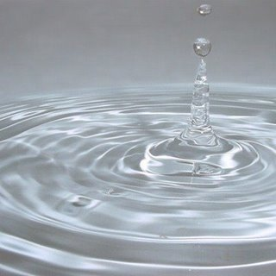
Water?
Yes!

Slide 9
Light?
No

Slide 10
Air?
Yes!

Slide 11
Sounds?
No

Slide 12
Emotions?
No

Slide 13
Examples of Matter
Book
Desk
Person
Air
Water

Slide 14
Non-examples of Matter
Light
Sound
Thoughts
Emotions

Slide 15
Physical Properties of Matter
Characteristic of a substance that can be observed without changing it into another substance.

Slide 16
Texture
Smell
Taste
Color
Flexibility
Hardness
Weight
Freezing point
Melting point
Boiling point
Ability to dissolve (solubility)
State of Matter (s, l, or g)

Slide 17
Chemical Properties of Matter
Characteristic of a substance that describes its ability to change into a different substance

Slide 18
Ability to burn (Flammability)
Ability to rust
Ability to tarnish
Ability to react with other substances (ie: acids)

