Slide 1
Elements, Compounds, and Mixtures
Chapter 5

Slide 2
Matter

Slide 3
Matter
Pure Substances
Elements
Compounds
Mixtures
Heterogeneous
Homogeneous
Copper
Water
Salt and Pepper
Kool-Aid

Slide 4
Physical change
Does not make a different substance
Ex:
Melting
Freezing
Boiling/evaporation
Condensation
Sublimation
Dissolving
Bending
Crushing
Breaking
Chopping
Filtration
distillation

Slide 5
Chemical Change
Produces new substances

Slide 6
Pure Substances
A single type of matter with a specific composition and a specific set of properties
Includes elements and compounds

Slide 7
Elements
Pure substance
Simplest substances
Cannot be broken down into simpler substances by physical or chemical means
Made up of only one type of atom
Have unique physical and chemical properties
Examples: gold, silver, carbon, helium, calcium, etc. (over 100)

Slide 9
Compounds
Pure substance
Made up of two or more elements that are chemically combined
Can be broken down chemically but not physically
Have own set of physical properties that may be very different from their original parts.
Combine in definite ratios
Examples: H₂0, NaCl, CO_{2,} C₆H₁₂O₆

Slide 10
Chemical Formulas
H₂0 = water
NaCl = table salt
CO₂ = carbon dioxide
C₆H₁₂O₆ = sugar (glucose)
****the number of atoms for each element is determined by the number beside it. For example, water has 2 hydrogens and one oxygen.

Slide 12
Mixtures
Two or more substances that are not chemically combined
Substances in a mixture keep their own individual properties
Parts of a mixture are not in set ratios
Can be physically separated
Examples: Salad, soil, Kool-Aid, salt water, air, brass, salt and pepper

Slide 13
Separation Techniques
Melting
Boiling/Distilling
Magnets
Filtration
Evaporation
Chromatography

Slide 14
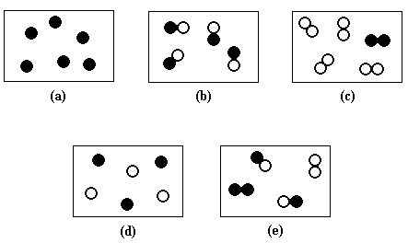
Identify the Following as a Element, Compound, or mixture

Slide 15
Types of Mixtures
1. Heterogeneous
2. Homogeneous

Slide 16
Heterogeneous Mixtures
Mixtures that are “different” throughout
Not evenly mixed; you can see the different parts
Examples: salt and pepper, soil, salad

Slide 17
Homogeneous
Mixtures that are the “same” throughout
Evenly mixed; you cannot see the different parts
Also called solutions
Examples: salt water, Kool-aid, air, brass

Slide 18
Solutions
Mixtures of two or more substances in which one or more of them seem to disappear in the other
Another name for a homogeneous mixture
Can be made up of solids, liquids, or gases.

Slide 19
Types of solutions
Liquid: Kool-aid, salt water
Gas: Atmosphere
Solid: Brass, stainless steel (alloys)

Slide 20
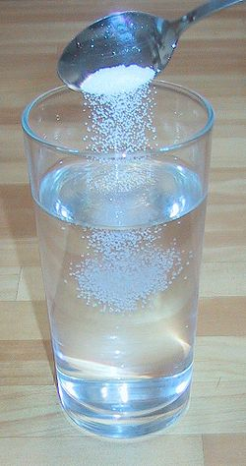
How do solutions Form?
By a process in which a substance breaks up into atoms, ions, and molecules.
Have two parts:
1. Solute: disappears or dissolves
2. Solvent: dissolves the solute
solute
solvent

Slide 21
Example
Kool-Aid
Solute: powder mix
Solvent: water
**usually more solvent
** because the solvent is usually water it is called the universal solvent
**solutions in which water is the solvent are called aqueous solutions

Slide 22
Determining solubility
Solubility: how much of a solute dissolves in a given solvent at a specific temperature
If a solute can be dissolved it is said to be soluble
If a solute cannot be dissolved it is said to be insoluble
Saturated: solution that contains all of the solute it can
Unsaturated: solution that does not hold all of the solute it can

Slide 23
Factors that Affect Solubility
1. Temperature: an increase in temperature causes an increase in solubility.
2. Pressure: an increase in pressure causes an increase in solubililty

Slide 24
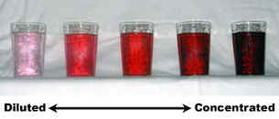
Determining Concentration
Concentration is how much solute there is compared to the amount of solvent
Concentrated: large amount of solute
Dilute: small amount of solute

Slide 25
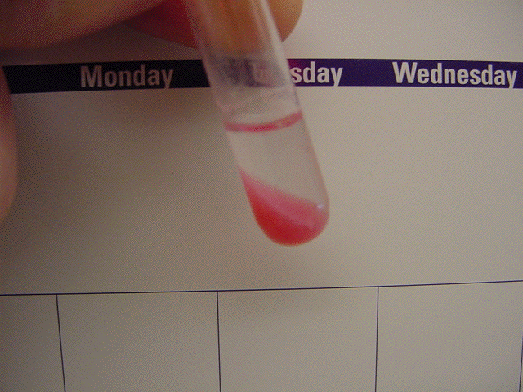
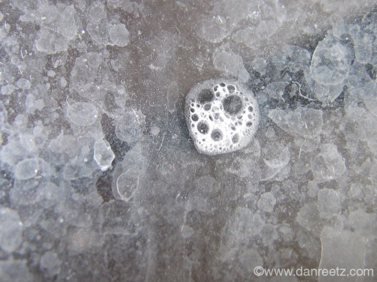
Precipitate
New solute that falls out of a solution by chemical means.
Examples: soap scum, stalactites/stalagmites

