Slide 1
Gravity
Section 1-2

Slide 2
Gravity
Force that attracts all objects towards each other
Measured in Newtons
Causes objects to fall towards Earth

Slide 3
Strength of Gravity
Depends on:
The mass of the object
Distance between the objects
Notes:
Earth has a strong gravitational pull on us and on the moon because it is so much bigger.
Ex: Mars has less of a gravitational pull on our moon than Earth does because it is further away.

Slide 4
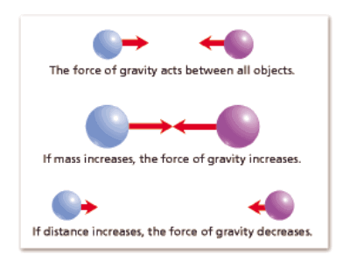

Slide 5
Mass vs. Weight
Mass does not change with location.
Weight can change with location because of gravity

Slide 6
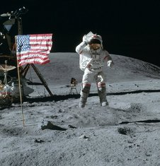
Why do we weigh less on the moon?
We would weigh 1/6 of our weight if we were on the moon.
Reason: Moon is smaller than Earth so it has less of a gravitational pull on us.

Slide 7
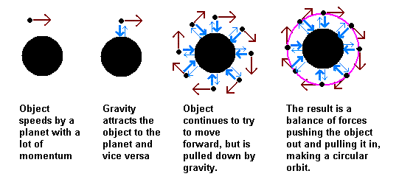
How does the moon stay in orbit around Earth?
Because of gravity and inertia!
Gravity pulls the moon towards Earth and inertia keeps it moving ahead.

