Slide 1
Muscles
Chapter 1, Section 4

Slide 2
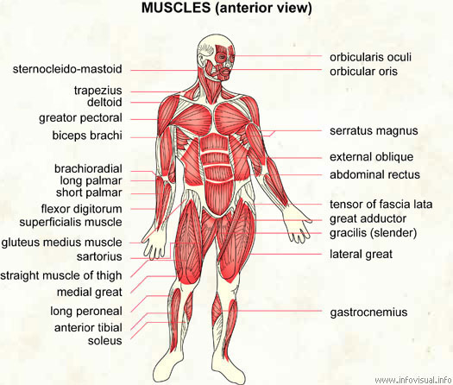

Slide 3
What is a muscle?
An organ that can relax and contract to allow movement
Attach to bones by tendons
More than 600 in our bodies
Smallest in our ears (stapedius)
Largest in our thighs (sartorious)

Slide 4
How do muscles work?
Works with your skeletal system.
Work in pairs- one muscle contracts, the other relaxes
Get the energy needed for movement from glucose.

Slide 5
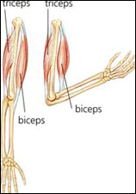

Slide 6
Voluntary vs. Involuntary
Voluntary muscles: you can control
Ex: biceps, triceps
Involuntary muscles: you do not consciously control
Ex: heart, lungs, digestive tract

Slide 7
Types of Muscle
Skeletal- help move our bones, voluntary; striated
Smooth- move internal organs; involuntary; non-striated
Cardiac- helps heart beat; involuntary; striated

Slide 8
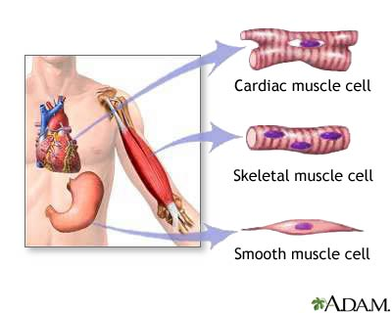

Slide 9
Taking care of your muscles
Exercise-helps cells grow in size
Warm up/stretch-increases blood flow to help muscle be more flexible
Well balanced diet (especially protein)

